Slide 1
Natural Variables vs. Renewable Energy
Ignacio Domaica, Jason Amaya,
Gregory Gibbs

Slide 2
Presentation
Introduction - Jason Amaya
Data Acquisition/Graphing- Ignacio Domaica
Conclusion/Analysis -Gregory Gibbs
Ja AmayaJason Amaya

Slide 3
Summary
(Correlation Study)
Is there a relationship between variables found in nature and the consumption of renewable energy in US cities?
Analysis of renewable power generation in random locations in USA.
Example:
“As the average wind speeds of cities increases, the consumption of the wind energy will increase.”

Slide 4
Hypothesis
Null Hypothesis: There is NO relationship between these given variables (eg. wind speed, elevation etc.) and how much renewable energy is consumed in a given state.
Alternative Hypothesis: There IS a relationship between these variables and the renewable energy consumption in each state.
***Hypothesis will be tested using the correlation coefficients of linear regressions in scatter plots.

Slide 5
Data acquisition & extraction
Project divided into 2 pieces of code that must be executed sequentially:
1_EXTRACTION_solar_wind_hydro.ipynb
2_ANALYSIS_solar_wind_hydro.ipynb
Generation of Latitude and Longitude random sets with numpy python library
Use Citypy to look for nearest city with geo coordinates.
Perform API calls with Openweathermap to access json meteorologic data
Filter to get USA data
Sample size of US Cities (260-290). Around 10% of cities in USA over 500 unhabitants (28.700)
Get elevation with reverse geocoding with google API maps, elevation. Obtain altitude (m)
Represent some maps with markers for USA cities, heat layers for wind and altitude
Get additional data from (https://simplemaps.com/data/us-cities) like
state_id
State
timezone
Get additional data from (https://www.currentresults.com/Weather/US/weather-averages-index.php) like
Sun Radiation (h)
Precip_inch
Precip_mm
Get additional data from Census Bureau Tables (https://www.census.gov/data/tables.html) (https://bit.ly/3fiPEcJ) like
mean elevation feet
mean elevation meters
Get additional data from (https://www.currentresults.com/Weather/US/weather-averages-index.php) like
Hydro cons (BTU)
Solar cons (BTU)
Wind cons (BTU)

Slide 6
Data Sources
Latitude and Longitude random sets with numpy python library
Citypy to look for nearest city with geo coordinates.
Openweathermap. https://openweathermap.org/ for API, json with meteorological data
Google for plotting maps and diverse data
Reverse geolocation to get altitude https://maps.googleapis.com/maps/api/elevation/json https://developers.google.com/maps/documentation/elevation/start
https://simplemaps.com/data/us-cities
Census Bureau Tables https://www.census.gov/data/tables.html https://bit.ly/3fiPEcJ
https://www.currentresults.com/Weather/US/weather-averages-index.php averages are based on data collected by weather stations throughout each state from 1971 and provided by the NOAA National Climatic Data Center.
US department of Agriculture. https://wcc.sc.egov.usda.gov/nwcc/site?sitenum=2168
CORGIS https://corgis-edu.github.io/corgis/csv/
CORGIS https://corgis-edu.github.io/corgis/csv/weather/
https://windexchange.energy.gov/maps-data
https://www.nrel.gov/research/data-tools.html
https://power.larc.nasa.gov/data-access-viewer/

Slide 7
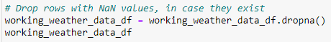
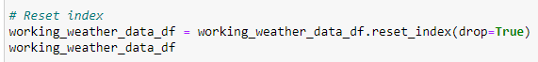
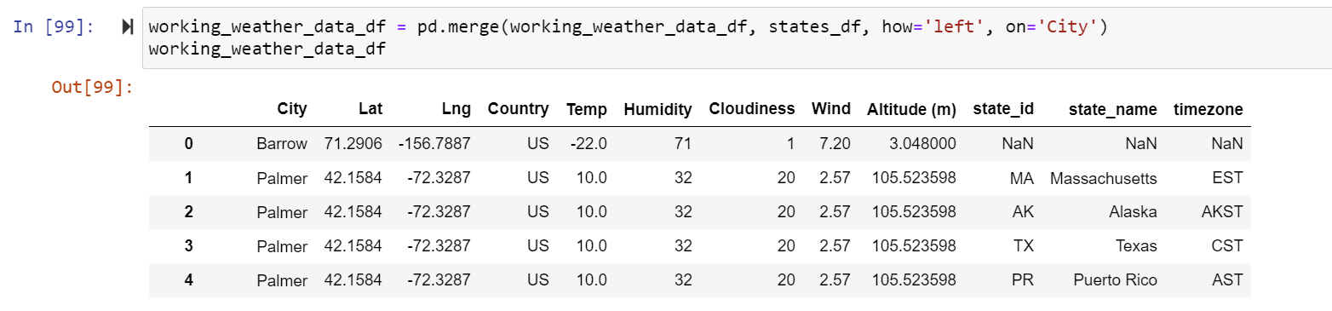
Data Cleanup
Most typical procedures were:
Drop rows with NaN values
Eliminate duplicated values. e.g
Reset indexes
Eliminate 1st column of a Dataframe
Merging

Slide 8
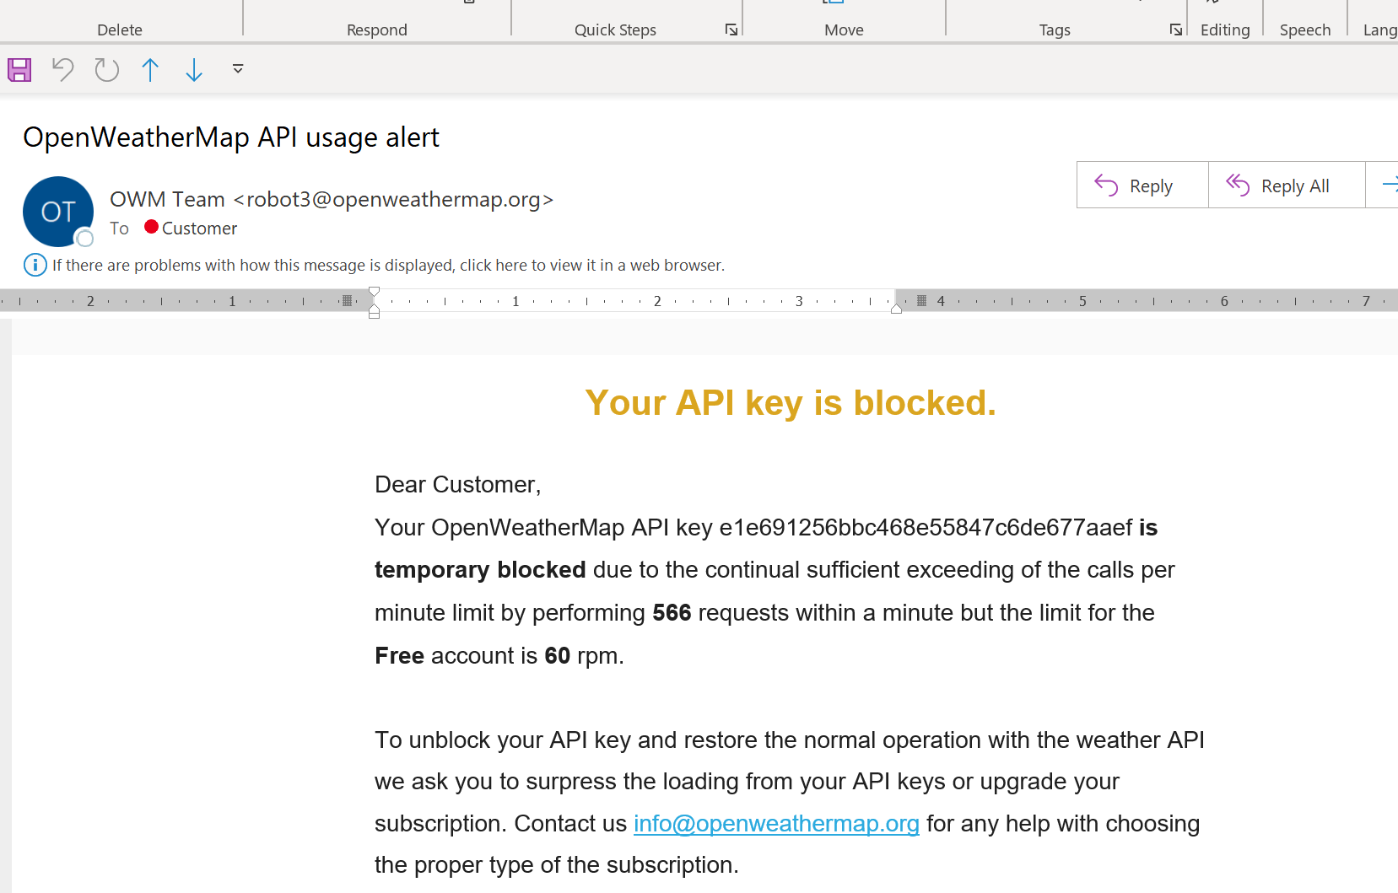
Data Cleanup
Save your dataframes data if possible in .csv format, so you avoid repeatedly API accesses
Careful saving or reading .csv.
There are two ways to handle the situation where we do not want the index to be stored in csv file.
https://stackoverflow.com/questions/20845213/how-to-avoid-python-pandas-creating-an-index-in-a-saved-csv

Slide 9
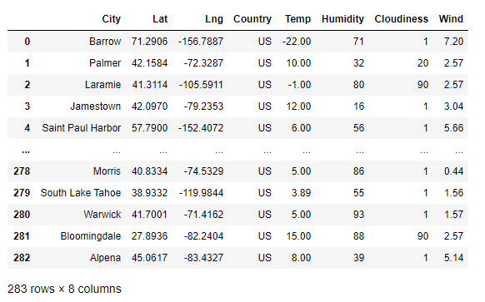
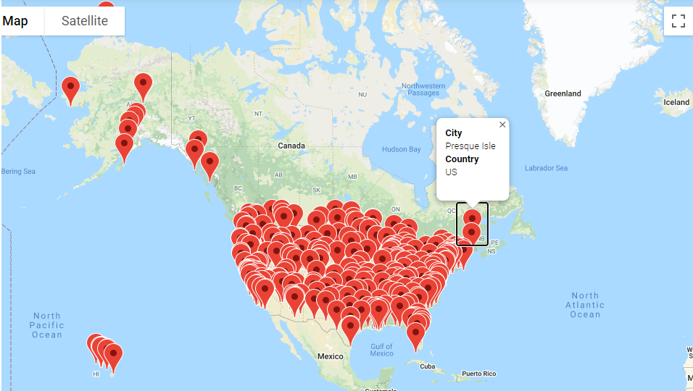
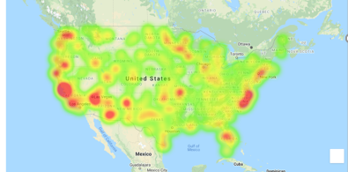
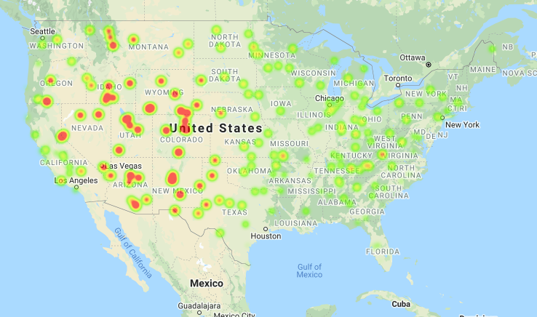
Data Extraction
Wind
Altitude

Slide 10
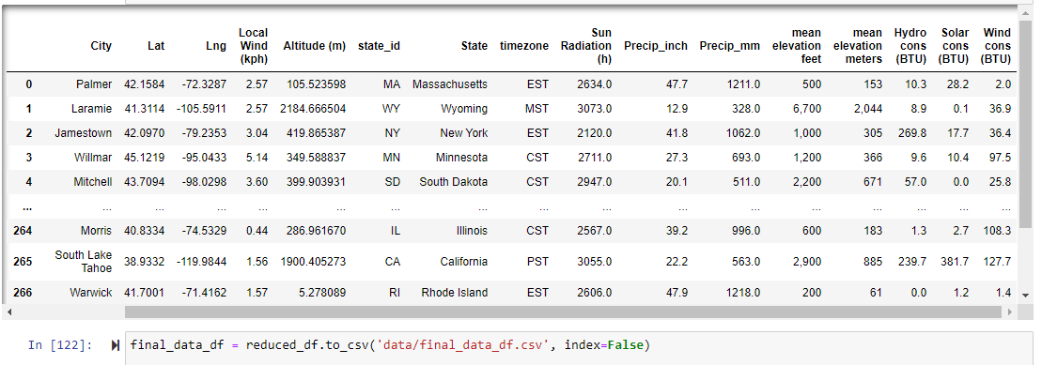
final_data_df

Slide 11
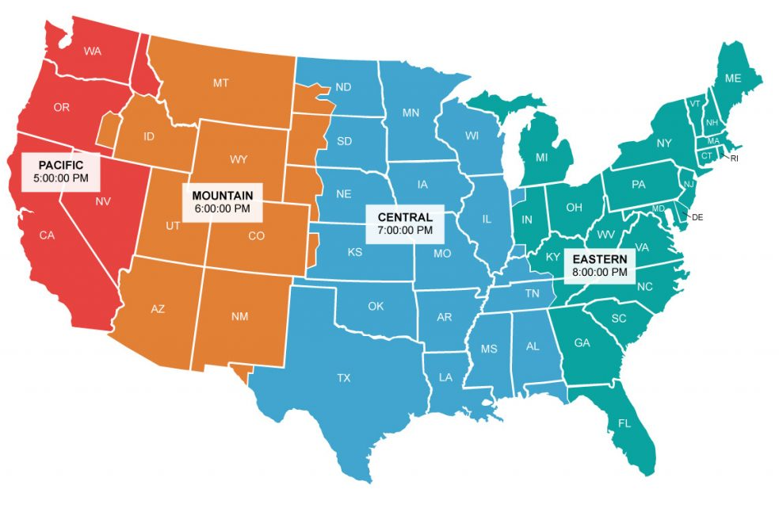
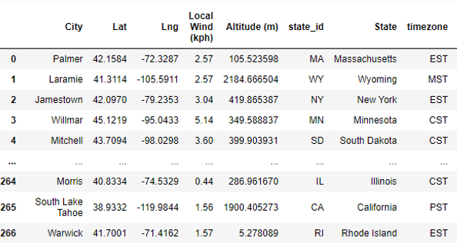
Chi-square. Ingredients

Slide 12
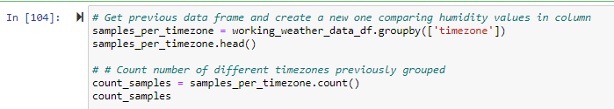
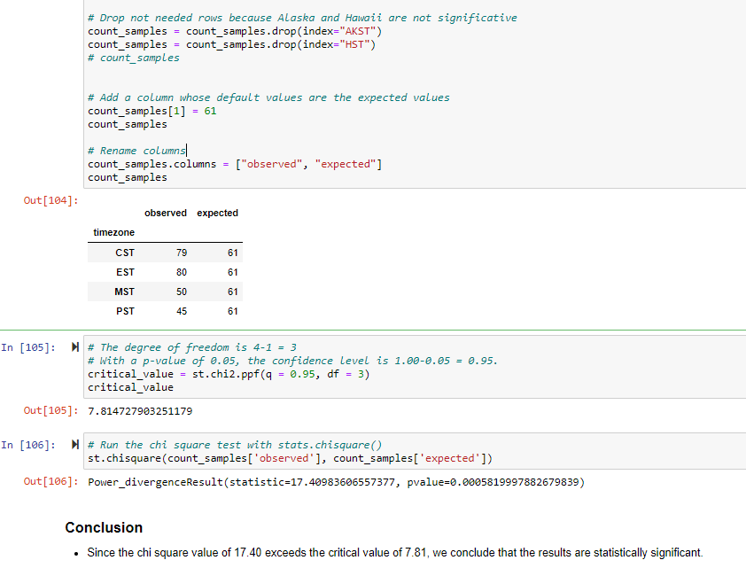
Chi-square. Results

Slide 13
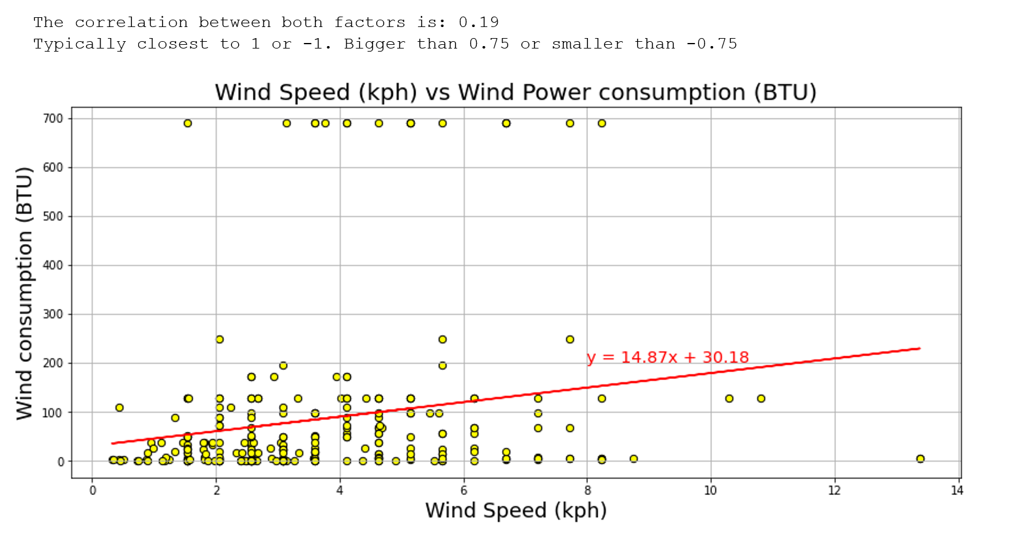
Data Plotting/ Linear Regression
(Avg. Wind Speed vs. Wind Energy Consumption )
Data Analysis

Slide 14
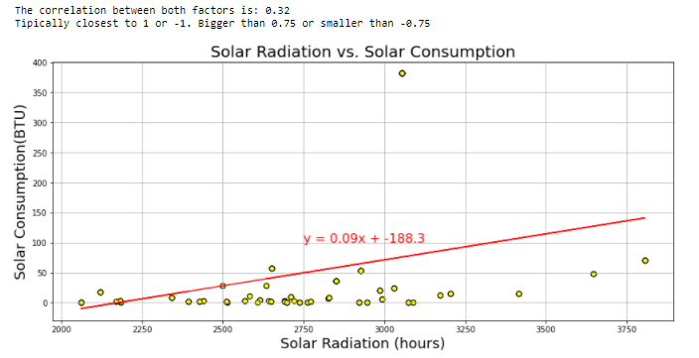
Solar Radiation vs. Solar Energy Consumption

Slide 15
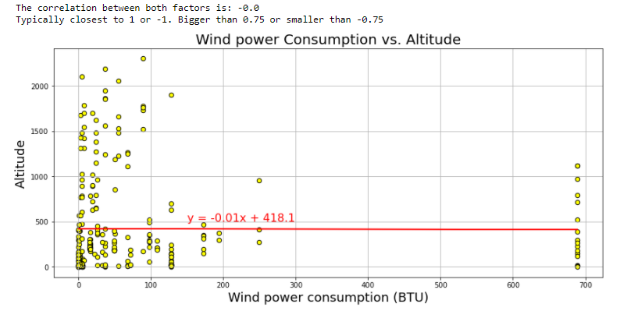
Elevation vs. WIND

Slide 16
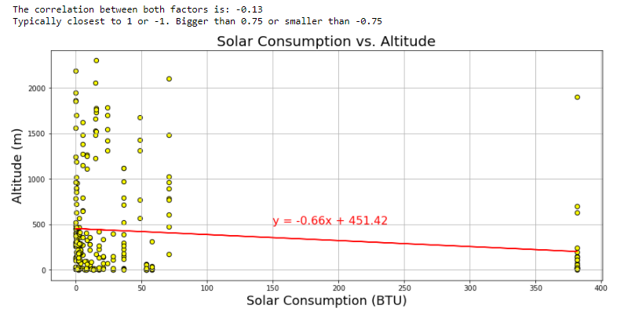
Elevation vs. Solar

Slide 17
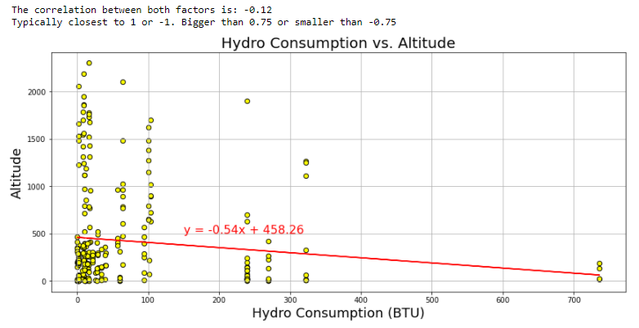
Elevation vs. Hydropower

Slide 18
Conclusion:
None of the graphs showed a strong correlation between the variables and the statewide consumption.
-correlative coefficients were closer to zero than 1/-1
***Could NOT reject Null Hypothesis

Slide 19
Post Mortem
Difficulties?
City vs. Statewide (had to be flexible)
Adapting the plan to the data available to us.
Reasons for Null:
Other factors- financial barriers, culture/politics, fossil competition
Unknown Third Variable
Other factors-(Data is not in a vacuum)
What would we do if given more time?
-Searched for more possible variables.
-Combined Variables
-Tested Hypothesis with different city sample
Bigger Budget to buy more data
How important is the plan, although is necessary to be flexible too.

Slide 20
BACK UP

Slide 21
Solar power consumption vs Altitude. Correlation. Regression

Slide 22
Hydropower consumption vs Altitude. Correlation. Regression

Slide 23
Eolic/Wind power consumption vs Altitude. Correlation. Regression

Slide 24
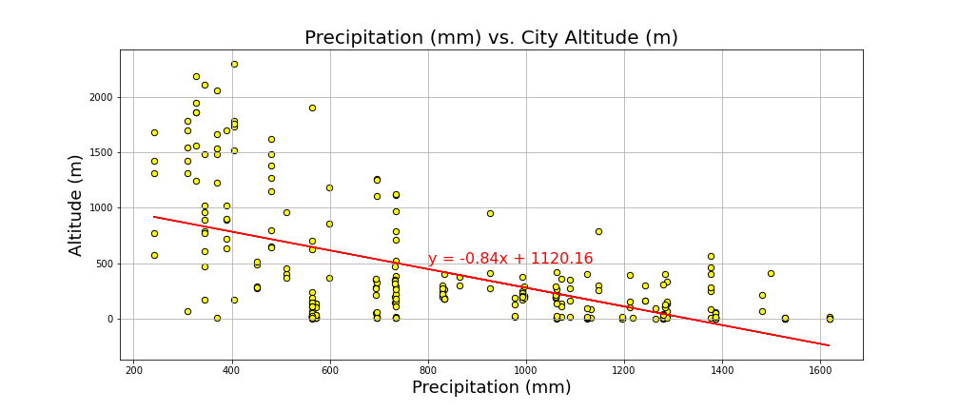
Precipitation vs Altitude. Correlation and regression
The correlation between both factors is: -0.58
Typically closest to 1 or -1. Bigger than 0.75 or smaller than -0.75

Slide 25
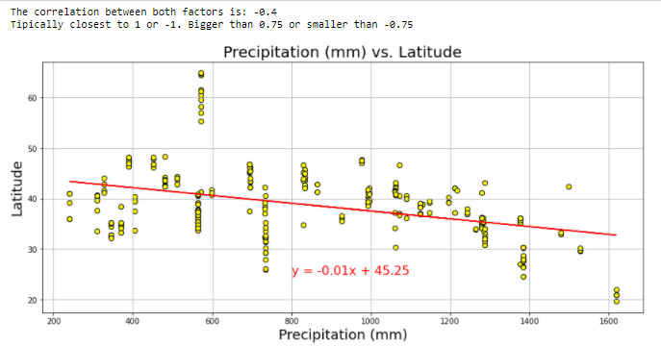
Precipitation vs Latitude. Correlation and regression

Slide 26
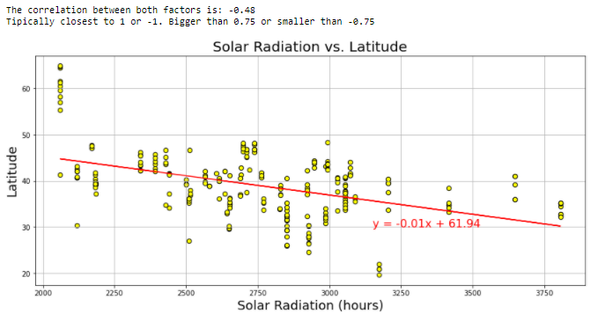
Solar Radiation vs Latitude Plot. Correlation. Regression

Slide 27
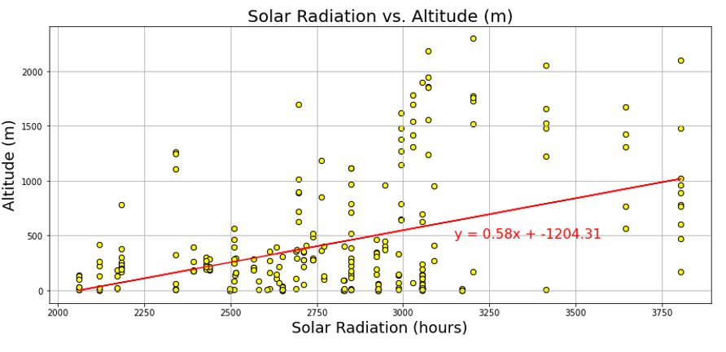
Solar Radiation vs Altitude Plot. Correlation. Regression
The correlation between both factors is: 0.44 Typically closest to 1 or -1.
Bigger than 0.75 or smaller than -0.75

Slide 28
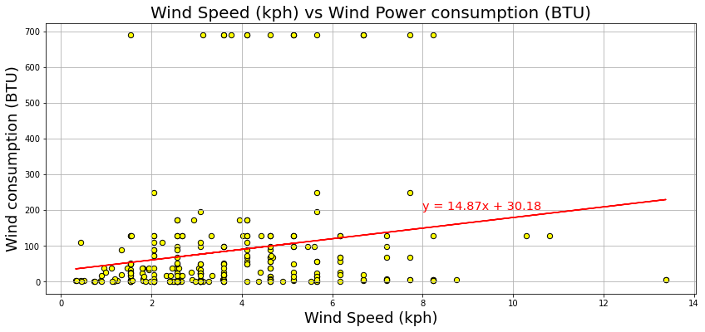
Wind Speed (kph) vs Wind Power consumption Plot. Correlation. Regression
The correlation between both factors is: 0.19
Typically closest to 1 or -1. Bigger than 0.75 or smaller than -0.75

Slide 29
Solar Radiation vs Solar consumption. Correlation. Regression

Slide 30
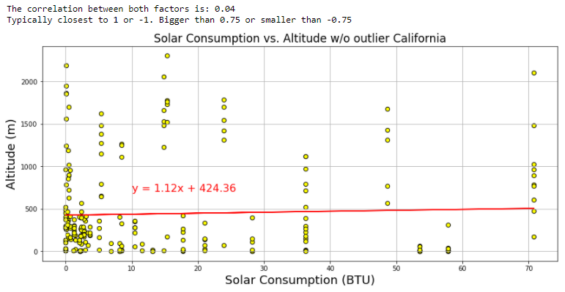
Check consumption eliminating outliers. Solar / California

Slide 31
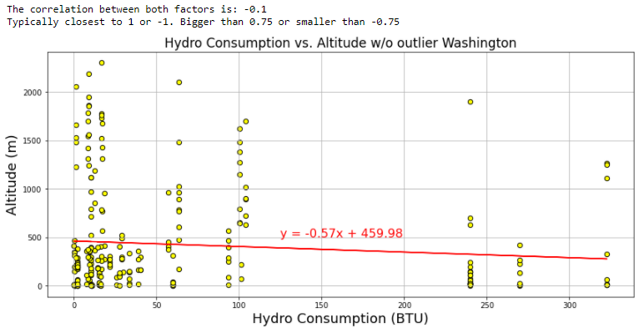
Check consumption eliminating outliers. Hydro / Washington

Slide 32
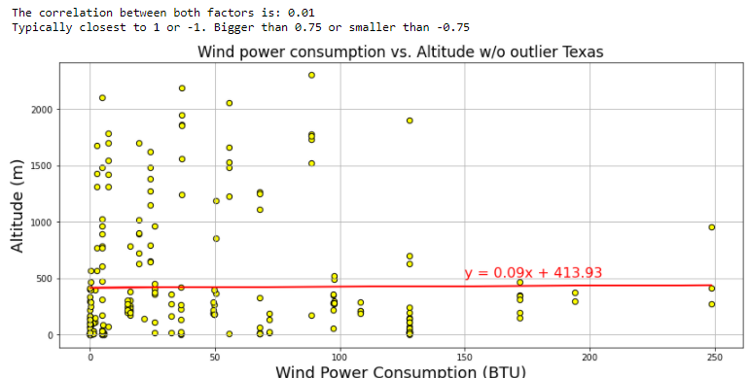
Check consumption eliminating outliers. Wind / Texas

Slide 33
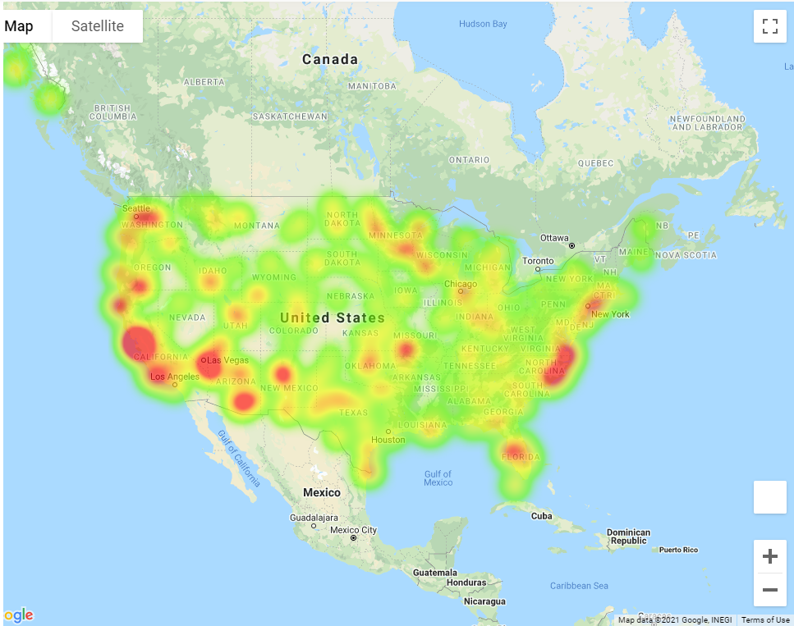

Slide 34
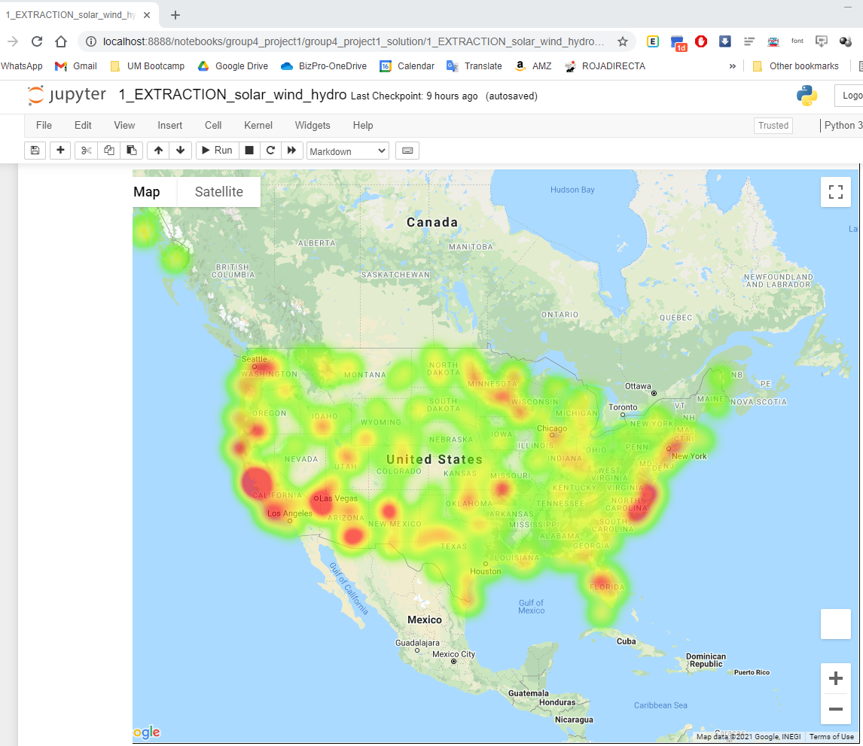

Slide 35
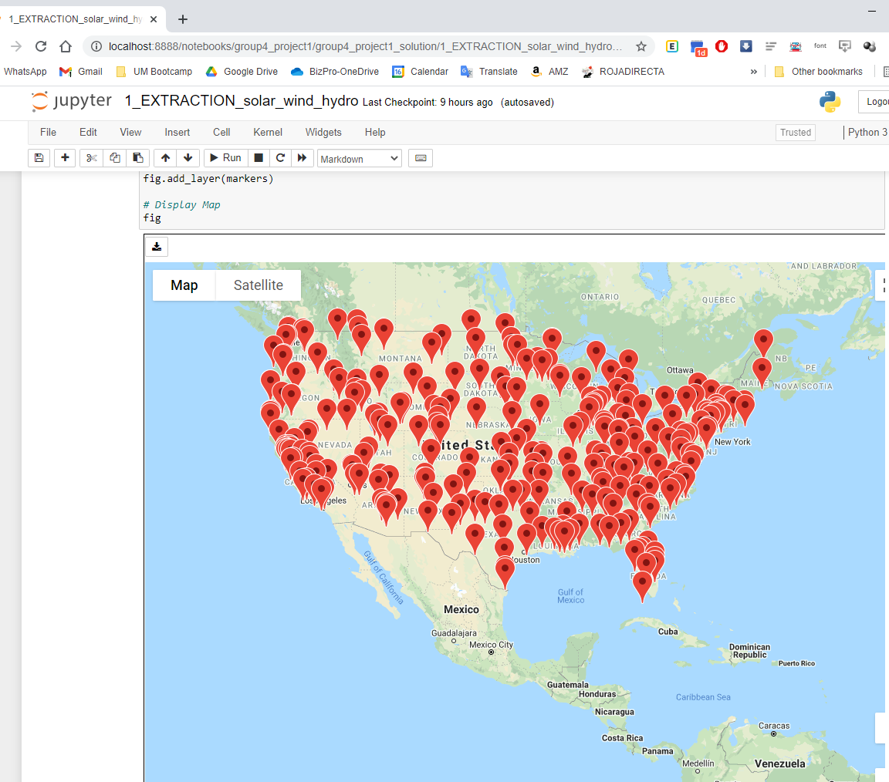

Slide 36
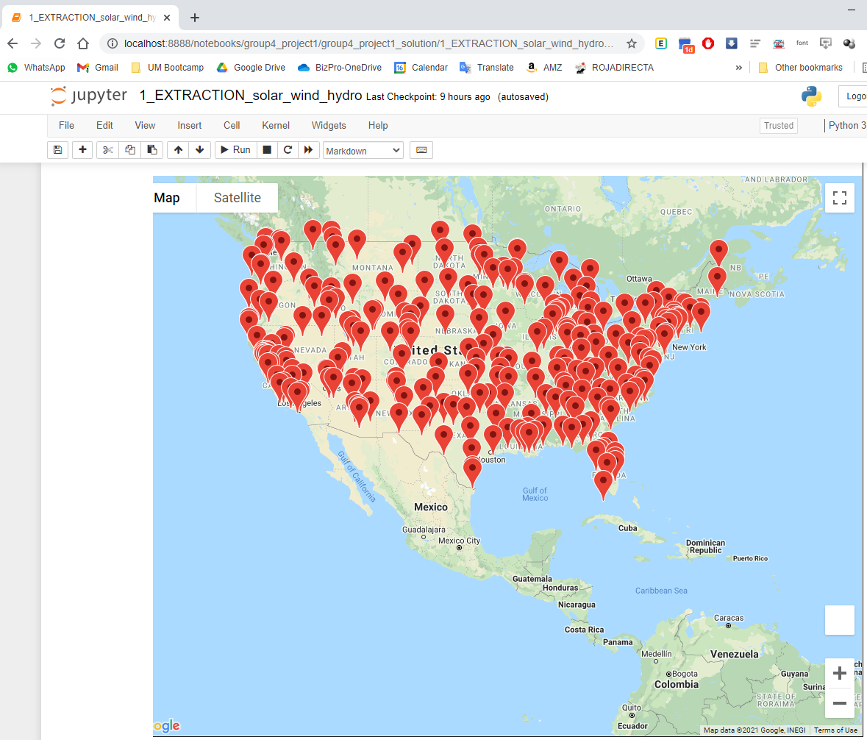

Slide 37
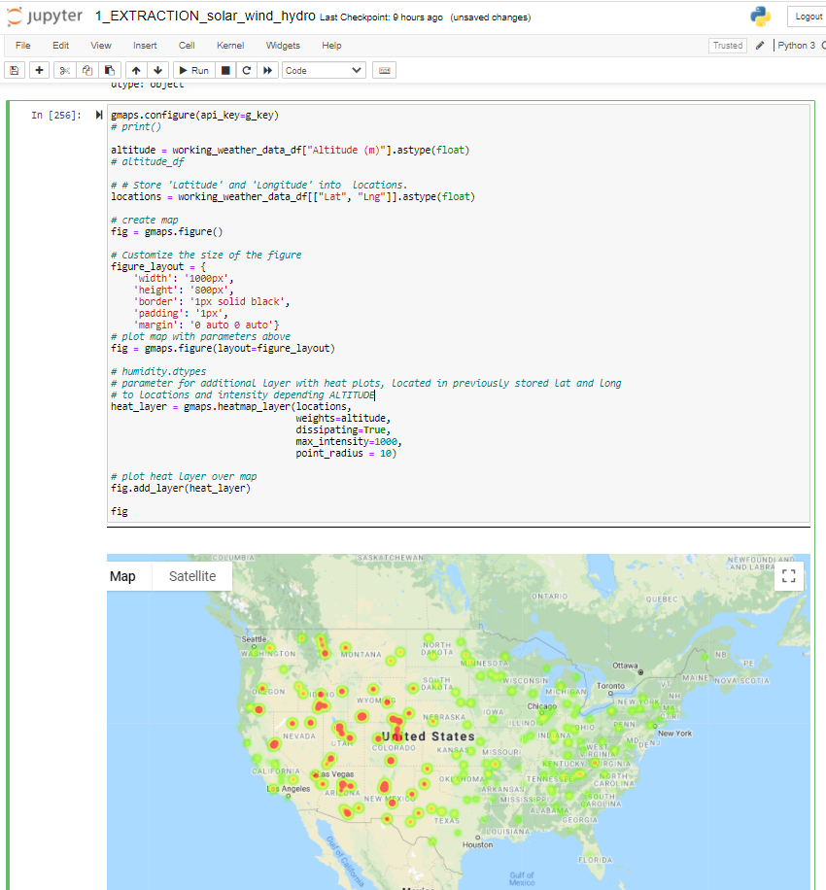

Slide 38
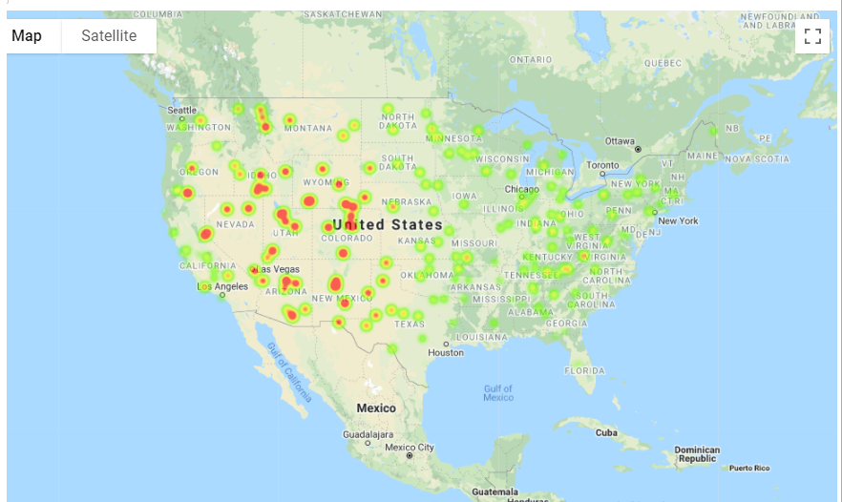

Slide 40
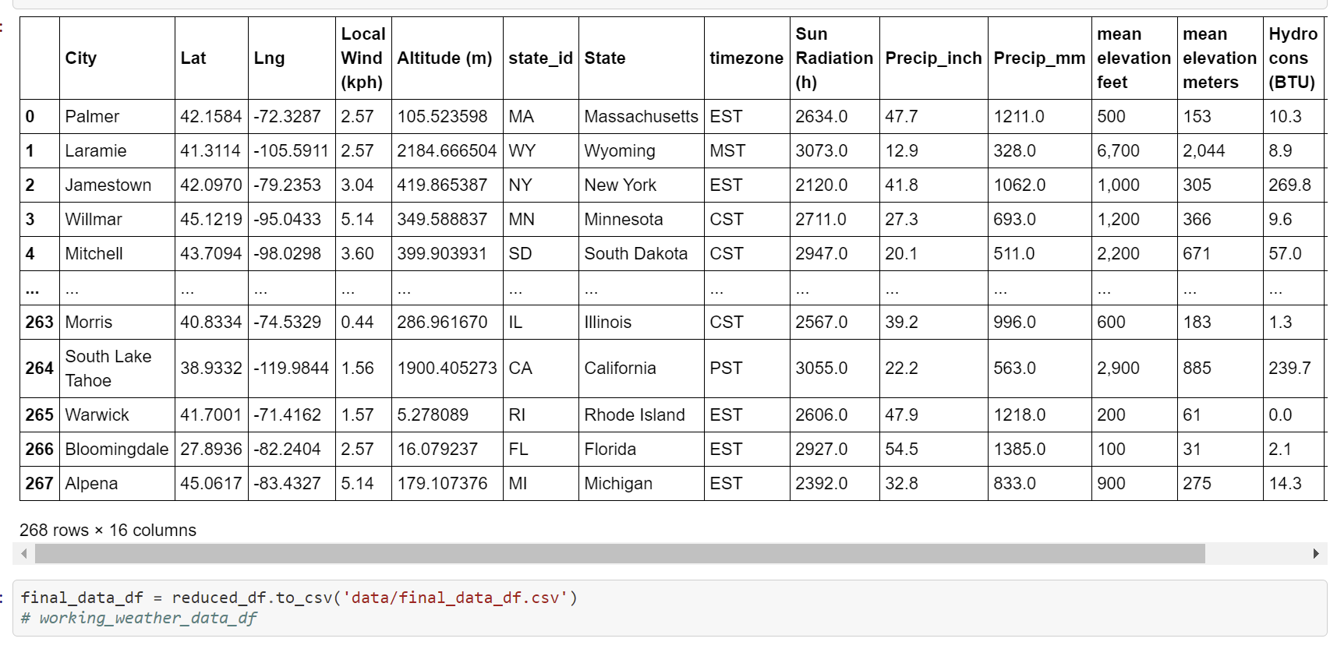

Slide 41
